Slide 1
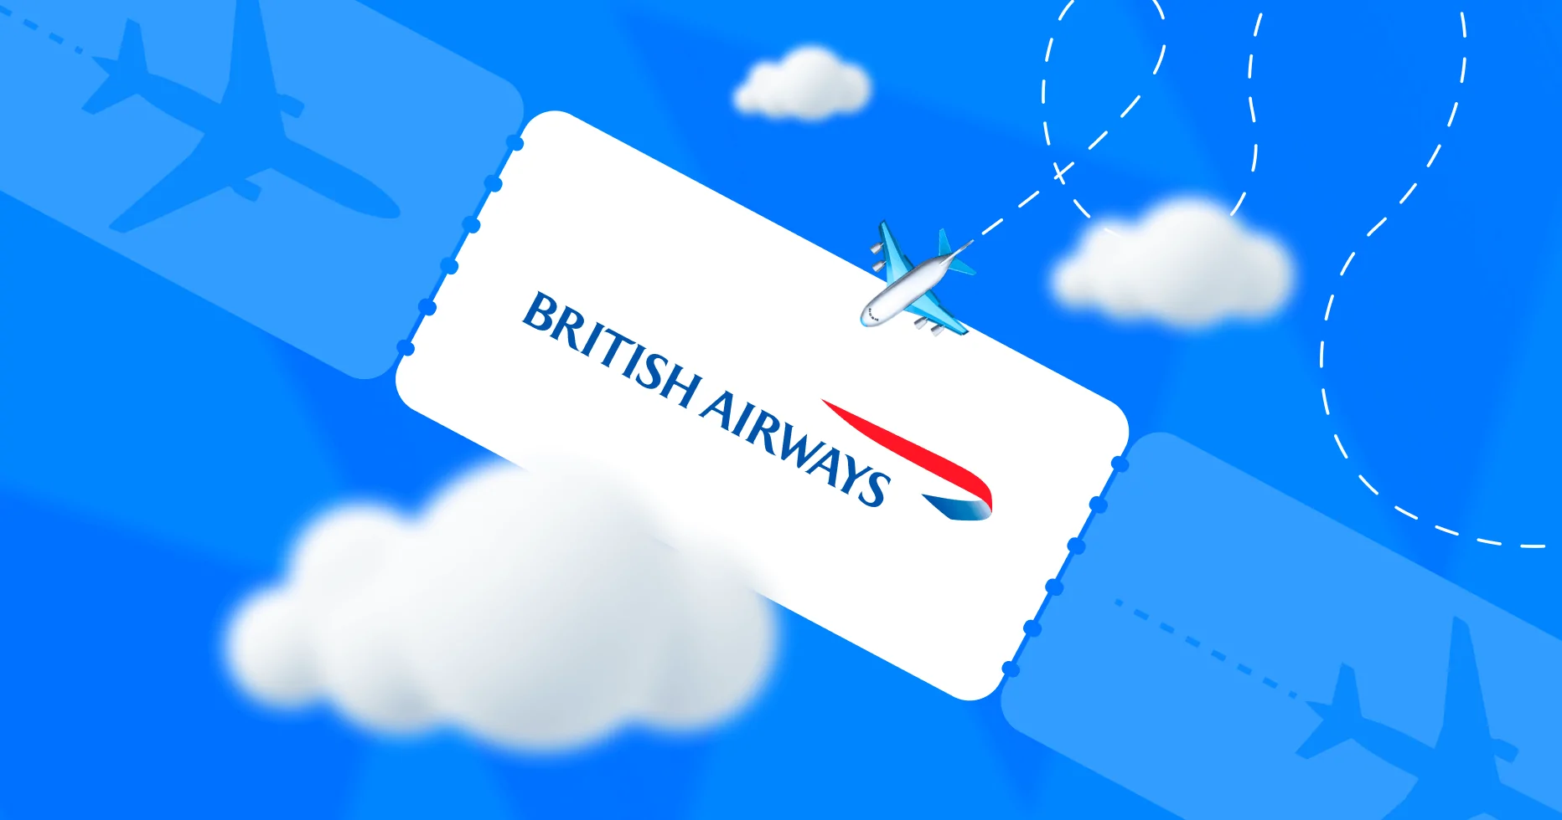
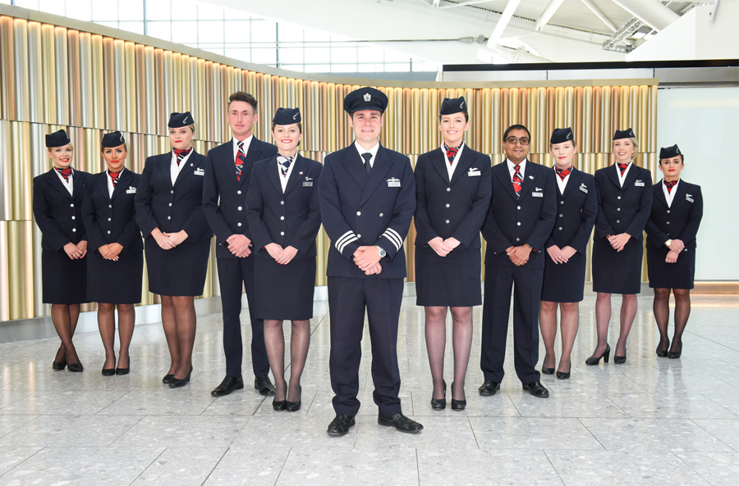
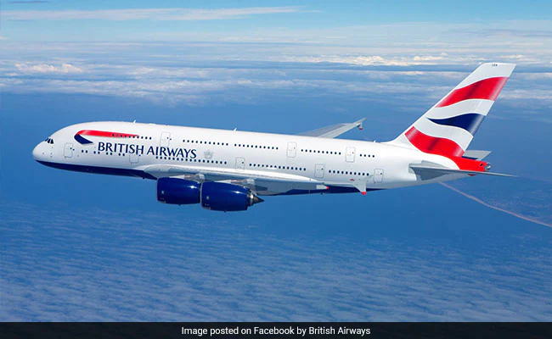
Sentiment Analysis Project: British Airways
Task 1 Presentation
By
EMMANUEL Nenchin

Slide 2
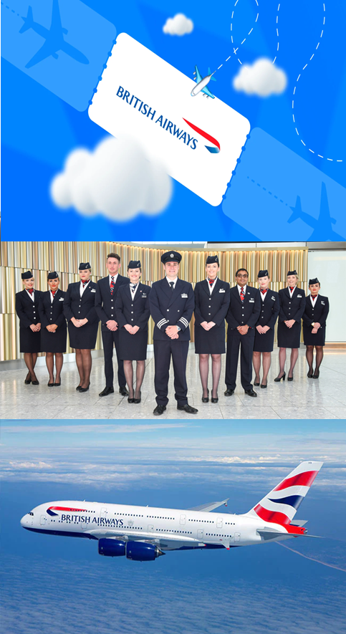
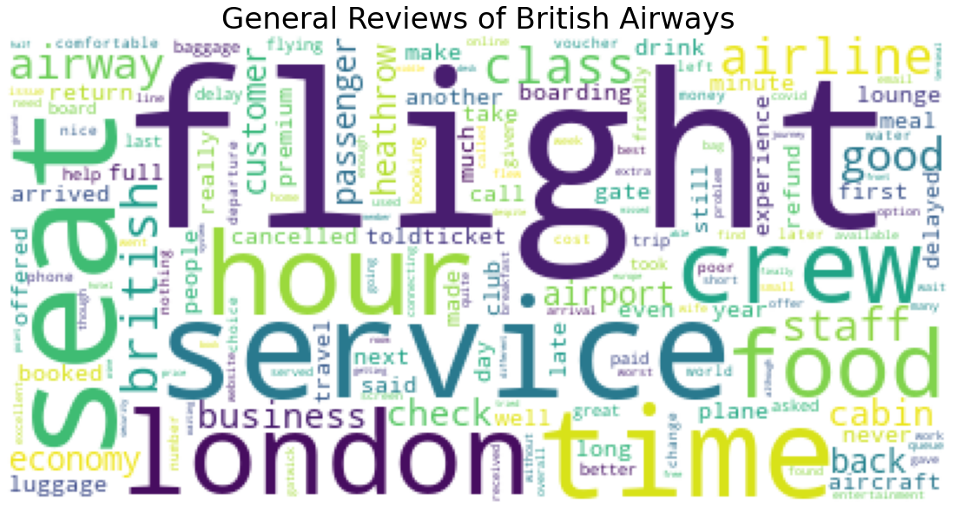

Slide 3
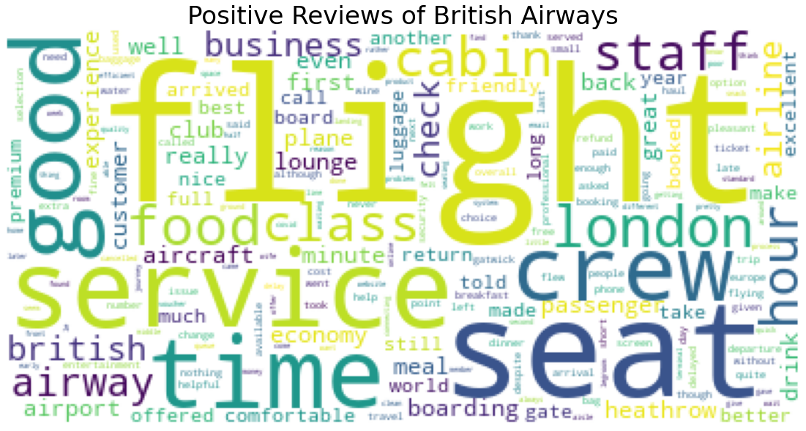

Slide 4
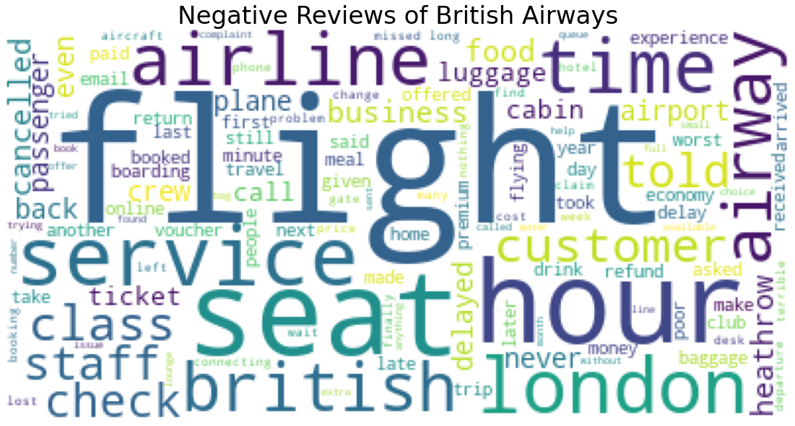

Slide 5
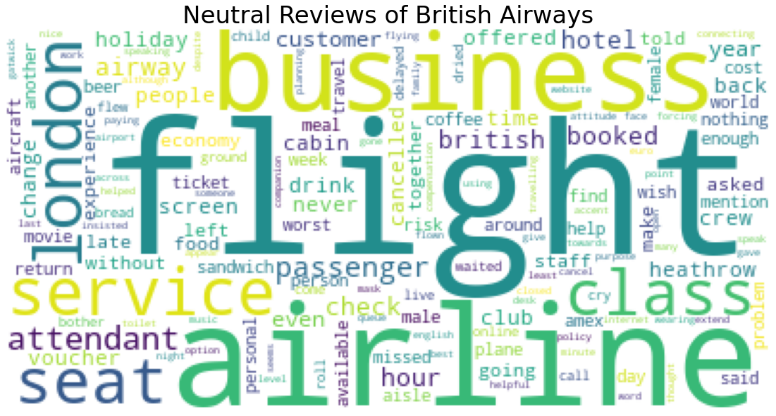

Slide 6
Sentiment | Frequency
Positve | 576
Negative | 404
Neutral | 20

Slide 7
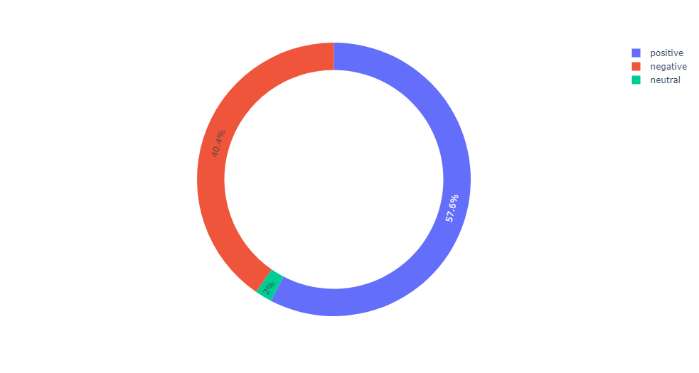

Slide 8
Intervention required on:
Delayed flight
Flight cancellation
Luggage
Food
Customer service/support

